Slide 1

Creating a To-Do List with HTML, CSS, and JavaScript
October 29, 2023

Slide 2
Agenda
Creating a To-Do List with HTML, CSS, and JavaScript
Introduction
How it Works
HTML Structure
CSS Styling
JavaScript Functionality
Uses, Advantages, and Disadvantages
Future Scope

Slide 3
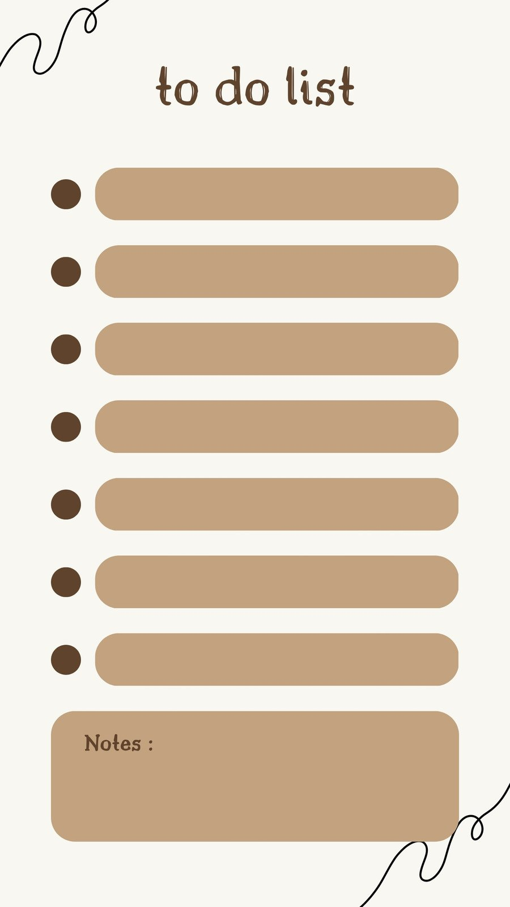
Creating a To-Do List with HTML, CSS, and JavaScript
Benefits of a To-Do List
Helps you stay organized and prioritize tasks
Improves productivity and efficiency
Reduces stress and overwhelm
Allows you to track progress and accomplishments

Slide 4
Introduction
To-do lists play a crucial role in organizing tasks and improving productivity in daily life.
The goal of this presentation is to provide a practical guide on creating a to-do list using HTML, CSS, and JavaScript.
By the end of this presentation, you will have a clear understanding of the key components and functionality required to build your own to-do list application.

Slide 5

How it Works
HTML
CSS
Defines the structure of the to-do list
Includes elements for tasks, input fields, and buttons
Allows for easy manipulation of the list
Styles the to-do list with colors, fonts, and layout
Makes the to-do list visually appealing and user-friendly
Helps to organize and group tasks
Plus tip:

Slide 6

HTML Structure
HTML Structure
The main structure of the to-do list is created using HTML elements such as <ul> (unordered list) and <li> (list item).
Each task in the to-do list is represented by an <li> element.
Input fields for adding new tasks are created using the <input> element with the type attribute set to 'text'.
Buttons for adding, deleting, and marking tasks as completed can be created using the <button> element.
Plus tip:

Slide 7
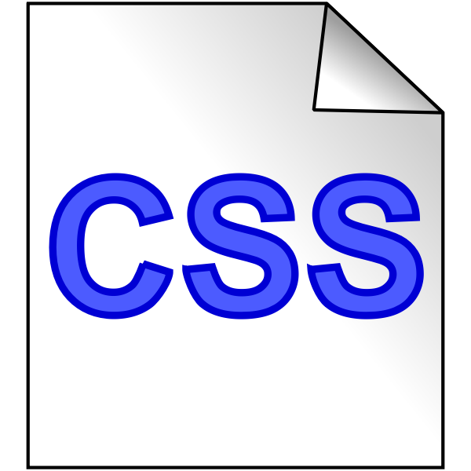
CSS Styling
Styling the To-Do List with CSS
CSS is crucial for enhancing the visual appeal of the to-do list.
It allows you to apply customized styles, such as colors, fonts, and spacing.
CSS selectors enable targeting specific elements within the to-do list for styling purposes.
CSS properties like background-color, font-family, and border-radius can be used to modify the appearance.

Slide 8
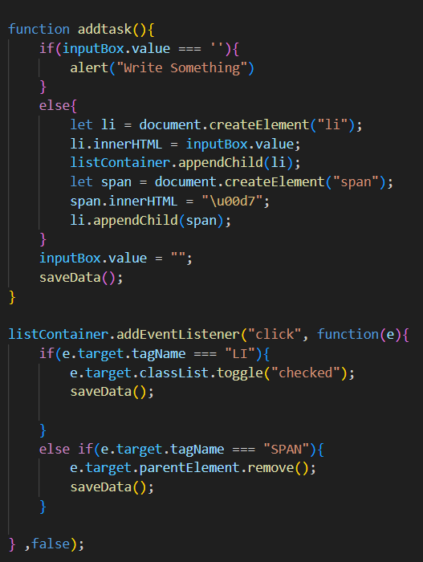
JavaScript Functionality
JavaScript Code
Tasks are added to the list using the JavaScript 'appendChild' method.
The 'removeChild' method is used to remove tasks from the list.
To mark a task as completed, the JavaScript code updates the CSS class of the task element.
Additional functionality can be added to the to-do list by customizing the JavaScript code.

Slide 9
Uses, Advantages, and Disadvantages
Use Cases
- Personal: Keeping track of personal tasks and goals
- Professional: Managing work-related tasks and deadlines
- Educational: Organizing assignments and study schedules
Advantages
- Organization: Helps in organizing tasks and priorities
- Productivity: Increases efficiency and time management
- Accountability: Provides a clear view of pending tasks and progress
Disadvantages
- Over-reliance: Depending too much on the to-do list may lead to a lack of spontaneity
- Clutter: A long list of tasks can become overwhelming and demotivating

Slide 10
Future Scope
Enhancements
Features
Reminders: Implement a reminder feature to help users keep track of important tasks and deadlines.
Cloud synchronization: Allow users to sync their to-do lists across multiple devices for easy access and seamless updates.
Integration with other apps: Enable integration with popular productivity apps such as calendars, email clients, or task management tools.
Collaboration: Add the ability for multiple users to collaborate on a shared to-do list, allowing for efficient teamwork.
Priority levels: Introduce a feature that allows users to assign priority levels to tasks, helping them prioritize their work.
Progress tracking: Implement a progress tracking feature that shows the completion status of tasks and provides insights on productivity.
Plus tip:

